Slide 1
Project R
CI 102 Team 13

Slide 2
Overview
Current Progress
Developed Mechanics
Prototype
Future Goals
Demonstration
Conclusion

Slide 3
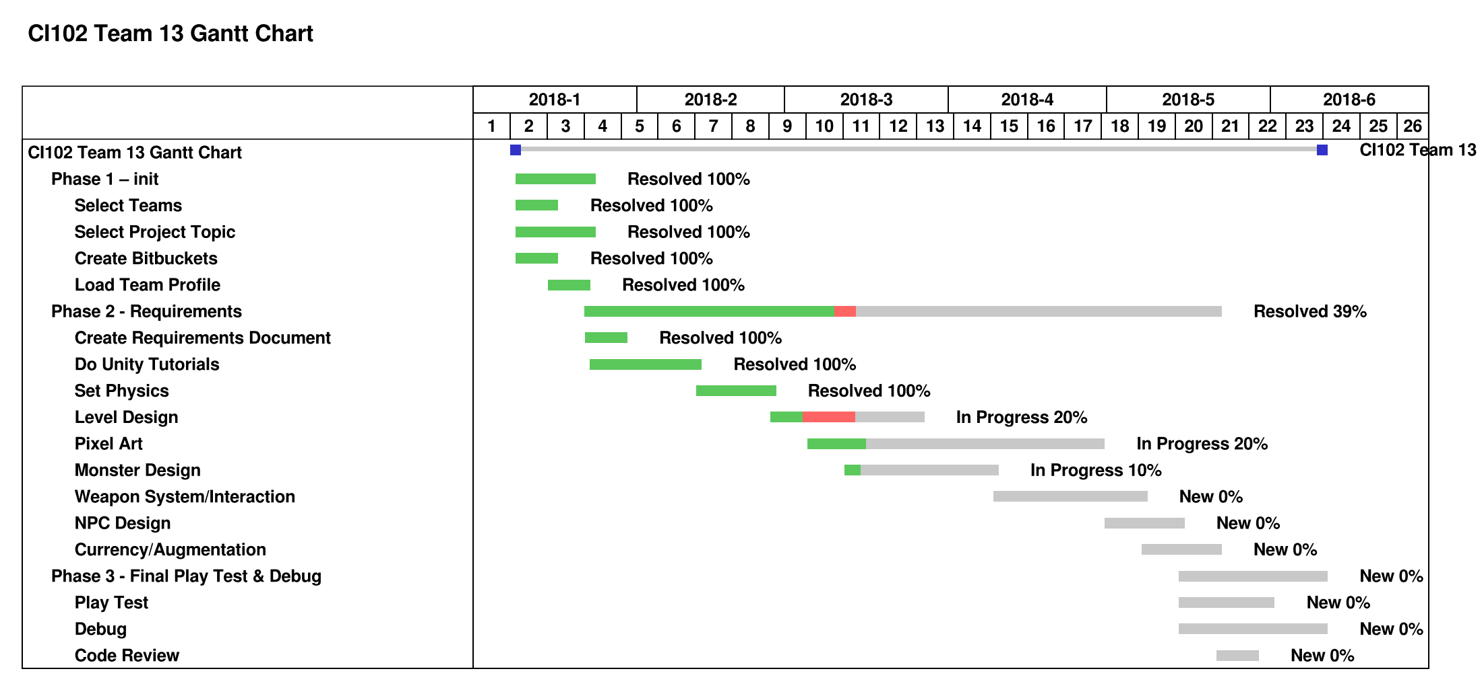
Current Progress

Slide 4
Developed Mechanics
Character Movement
Hit Point System
Traps and Enemies
Animations
Combat System

Slide 5
Prototype
Goal: To implement a suitable enemy AI
Current Method: Enemies follow the player in range
Future Development:
Predict player’s movement
Conditional actions

Slide 6
Reflection
Learned…
How to use Unity Engine
How to utilize collaborative tools
How to apply assets
How to code in C#

Slide 7
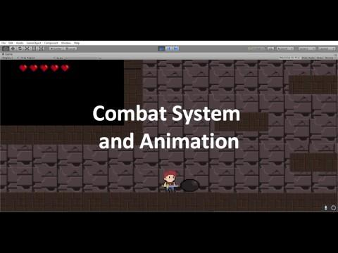
Demonstration

Slide 8
Questions?

